Slide 1
Problem Statement
Machine Learning-Driven Device Circuit Co-optimization

Slide 2
Objectives
Predict and optimize the inverter design {width(W), length(L), number of transistors(N)} to meet specified power and delay requirements for advanced nanosheet FET and CFET-based technologies.
Develop an analytical model for inverter delay and power as functions of key parameters such as effective current and capacitance. (Jan – Feb)
Validate the analytical model through TCAD mixed-mode simulations to ensure accuracy and reliability under various operating conditions. (Feb – March)
Build a deep neural network (DNN) -based forward model to predict current and capacitance values for inverter design parameters (W, L, N).
Implement advanced optimization techniques such as grid search, Bayesian optimization, or evolutionary algorithms to achieve efficient inverse design for the desired power and delay requirements. (March- April first week)

Slide 3
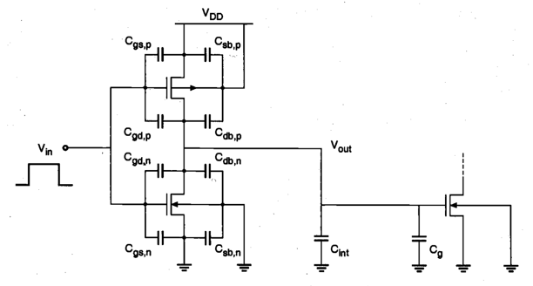
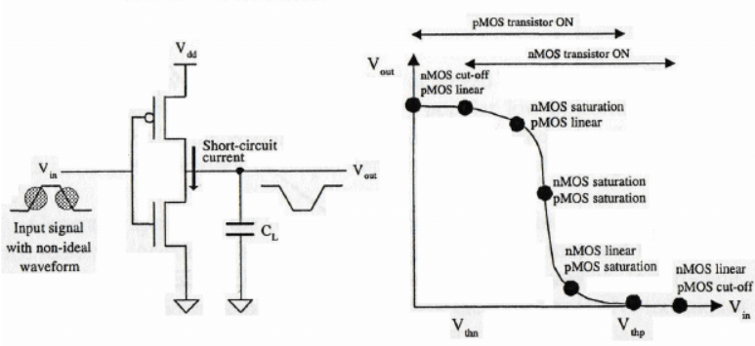
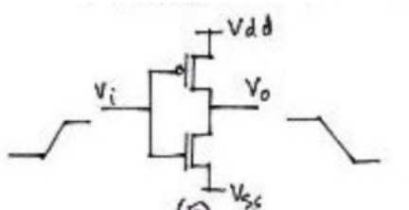
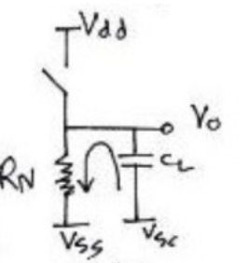
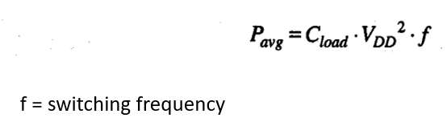
Task 1:-
Understand the basic concepts of inverter
Static and Dynamic Characteristics
Operating regions of CMOS inverter in VTC curve
Power Dissipation in CMOS inverters ; Power delay product
Reference :- (K. Kang and Y. Leblebici, CMOS Digital Integrated Circuits: Analysis and Design, 4th ed. New York, NY, USA: McGraw-Hill, 2014.)

Slide 4
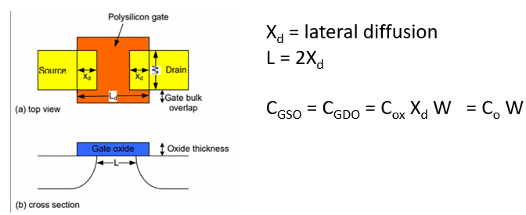
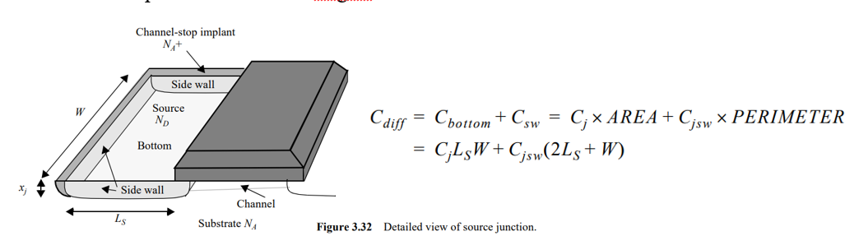
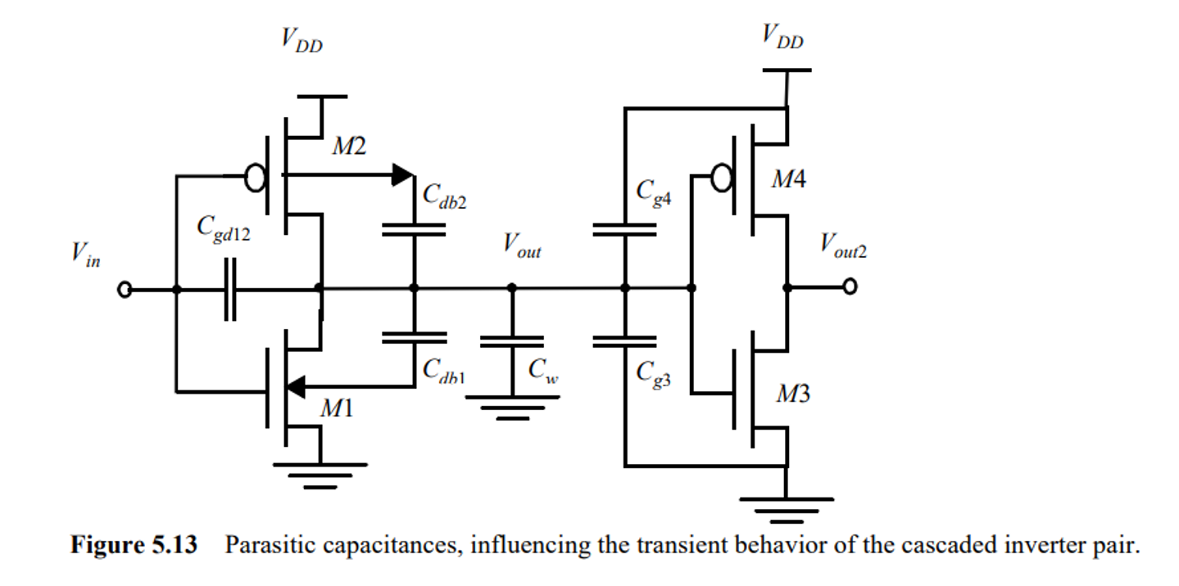
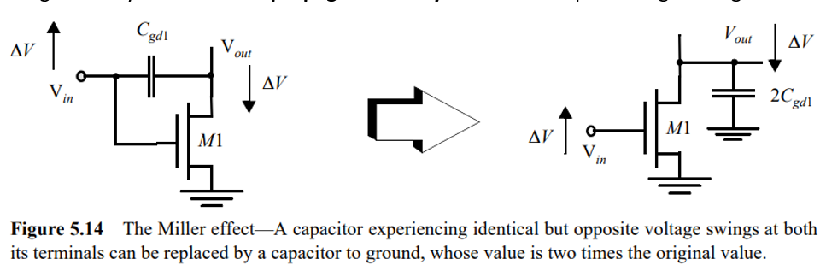
Task 2:-
Understanding of Parasitic Capacitance
The two major components to find propagation delay are C_{load} and Effective drive current
For Load Capacitances ; understanding the parasitic capacitances is crucial (Overlapping Capacitances , Diffusion Capacitances/Junction Capacitances, Gate channel capacitances, Gate Drain Capacitance(Miller Effect),Gate capacitance , wiring capacitance
C_{load} = C_{gd,n}+ C_{gd,p} + C_{db,n} + C_{db,p} + C_{int} + C_{g}
Reference :- J. M. Rabaey, Digital Integrated Circuits: A Design Perspective, 2nd ed. Upper Saddle River, NJ, USA: Prentice Hall, 2003.

Slide 5
τ_{PD} = CV_{DD}/I_{on} was used as a classical model to calculate propagation delay
I_{ON} was taken as I_{dsat} = I_{d}(V_{GS}=V_{DD} , V_{DS} = V_{DD})
Why I_{ON} was used? :-
It represents the peak drive strength of the transistor.
The actual transient current does not remain constant but stays close to this value during a significant portion of switching
The actual delay of a CMOS inverter depends on the transient current profiles during switching, which are influenced by the varying V_{gs}​ & V_{ds}​ voltages. I_{dsat}​, being constant, does not account for these variations and fails to capture the dynamics of switching accurately.
A new model was required other than the classical model which also captures the transient behavior
The classical model lead to underestimation of propagation delay as the actual mean current is lower than I_{ON} or I_{dsat}
M. H. Na, E. J. Nowak, W. Haensch and J. Cai, "The effective drive current in CMOS inverters," Digest. International Electron Devices Meeting,, San Francisco, CA, USA, 2002, pp. 121-124, doi: 10.1109/IEDM.2002.1175793. keywords: {Inverters;CMOS technology;Delay effects;Threshold voltage;FETs;Ring oscillators;Integral equations;Rivers;Testing;Semiconductor device modeling},

Slide 6
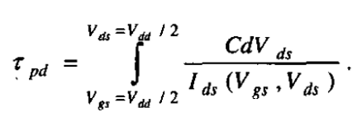
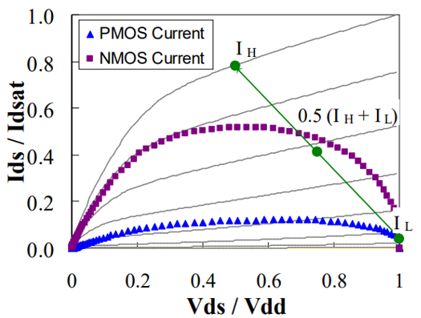

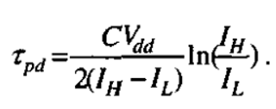
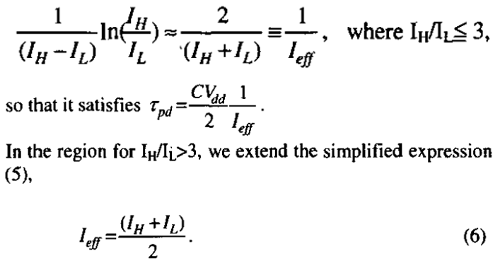
I_{H} = I_{ds} (V_{Gs} = V_{dd} and V_{Ds} = 0.5V_{dd} )
I_{L} = I_{ds} (V_{Gs} = 0.5 V_{dd} and V_{Ds} = V_{dd} )
Hu, Jenny, et al. "Effective drive current in CMOS inverters for sub-45 nm technologies." Proc. NSTI Bio-NanoTech. Conf. Trade Show. Vol. 3. 2008.

Slide 7
Still there are drawbacks for two point model:-
I_{H​} corresponds to the highest current the NMOS can deliver when operating along an ideal switching trajectory.
I_{peak}​ is the actual transient peak current observed during switching.
If I_{peak}​ falls much below I_{H}​, the inverter is not utilizing its maximum drive strength, which results in longer delay.
Pull Down switching trajectory for 250 nm technology
As the V_{TH} of a device decreases, the peak current in the trajectory occurs at a lower V_{gs}, further away from I_{H}.
Reason : As V_{th}​ decreases for a fixed V_{dd}​, the difference (V_{gs}​ - V_{TH}​) increases, enhancing the drive current in the MOSFET.
May be approximations about velocity saturation effects , short channel effects should be taken !!
Models like I_{H​} (for V_{GS}​ = V_{DD}; V_{DS}​ = 0.5V_{DD}​) assume I_{PEAK​} occurs when the gate voltage is fully charged to V_{DD}​..

Slide 8
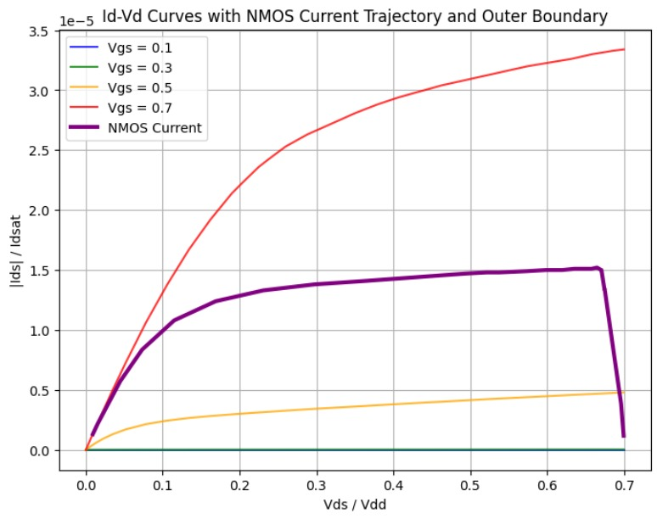
Checked the same via TCAD simulations for CFET with Channel width 20nm, Gate Length 12nm and Height 5nm and also explored for channel width of 30 nm .
The peak current for NMOS is not reaching when V_{GS} = 0.7 V
V_{th PMOS} = -0.415 V
V_{th NMOS} = 0.35 V
Rise Time = 1e-10
Fall Time = 1e-10
ON time = 1e-9
Period = 3e-9
For C_{L} = 10fF ; L=12nm ; H = 5nm
Channel Width(W) | τ_{P} (Theoretical one point model) | τ_{P} (Theoretical two point model) | τ_{P} (simulation) | % Error (1 point) | % Error (2 point)
30 nm | 1.825 X 10e-10 | 4.125 X 10e-10 | 2.65 X 10e-10 | 31.13% | 55.66%
20 nm | 2.54 X 10e-10 | 5.79 X 10e-10 | 3.66 X 10e-10 | 30.60% | 58.19%
I_{ON} n | I_{ON} p
4.34 X 10e-5 | 1.23 X 10e-5
3.33 X 10e-5 | 8.67 X 10e-6

Slide 9
Some More Papers Reviewed
C. F. Chen, M. H. Chiang, C. Hu, and P. K. Ko, “Alpha-power law MOSFET model and its applications to CMOS inverter delay and other formulas,” IEEE Journal of Solid-State Circuits, vol. 25, no. 2, pp. 584-594, Apr. 1990. doi: 10.1109/4.52187.
B. Andreev, E. L. Titlebaum, and E. G. Friedman, “Sizing CMOS inverters with Miller effect and threshold voltage variations,” J. Circuits, Syst., Comput., vol. 15, no. 3, pp. 437–454, Oct. 2006. doi: 10.1142/S0218126606003142.
F. S. Marranghello, A. I. Reis, and R. P. Ribas, “Improving analytical delay modeling for CMOS inverters,” J. Integr. Circuits Syst., vol. 10, no. 2, pp. 123–134, 2015.
L. Xue, A. Dixit, N. Kumar, V. Georgiev, and B. Liu, “Machine learning-assisted device circuit co-optimization: A case study on inverter,” IEEE Trans. Electron Devices, vol. 71, no. 1, pp. 1-10, 2024. doi: 10.1109/TED.2024.3476231.
N. Hedenstierna and K. O. Jeppson, “CMOS circuit speed and buffer optimization,” IEEE Trans. Comput.-Aided Des. Integr. Circuits Syst., vol. 6, no. 2, pp. 270–281, Mar. 1987. doi: 10.1109/TCAD.1987.1270271.

Slide 10
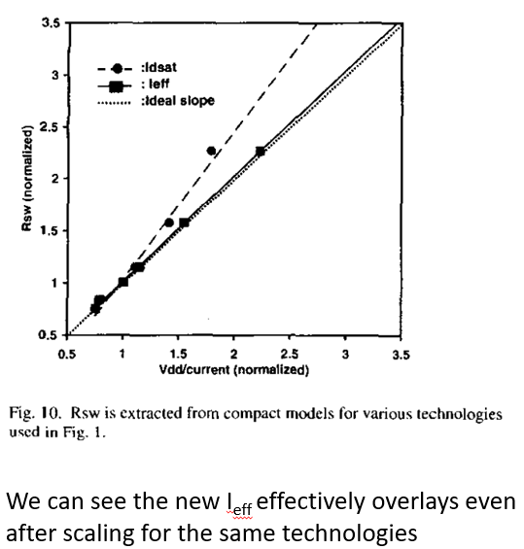
This change in current trajectories suggests that evaluating I_{H} at the same bias regardless of the device overdrive is not sufficient.
Also, the simplification of the parabolic current trajectory as a linear path from I_{L} to I_{H} is no longer a good approximation if the peak current is far below I_{H}.
So a model is proposed for I_{eff} which has more than two points.
V_{GS}​=0.75V_{DD}​ and V_{DS}=0.75V_{DD} represent an intermediate condition between the extremes (I_{H​} and I_{L}​).
This captures the behavior of the device at a typical mid-transition state during switching, providing a more balanced representation of the trajectory.
Older model approximates the current trajectory as a linear path between I_{H} and I_{L}.
A three point model of I_{eff} is introduced
I_{eff} = ( I_{H} + I_{M} + I_{L} )/3 ; I_{M} =I_{ds}(V_{gs}=0.75 V_{DD}, V_{ds}=0.75 V_{DD}).
Hu, Jenny, et al. "Effective drive current in CMOS inverters for sub-45 nm technologies." Proc. NSTI Bio-NanoTech. Conf. Trade Show. Vol. 3. 2008.
Including I_{M} intermediate point helps to approximate the non-linear trajectory of current more accurately. The current does not follow a perfect linear path between I_{H} and I_{L}​, and I_{M}​ provides a check against such oversimplifications. Therefore it’s a robust intermediate point.

